Slide 1
Covid-19 Vaccine Information

Slide 2
Nothing in life is to be feared, it is only to be understood. Now is the time to understand more, so that we may fear less.
-Marie curie

Slide 3
COVID-19 Vaccine Hesitation is real
Common concerns
“being first”, “being a Guinea pig”
Vaccine “being rushed”
Safety (side effects)
Groups not being represented in the vaccine trials
Other important factors
How protective is the vaccine?
How long does protection last?

Slide 4
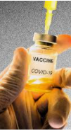
Why should I get vaccinated?
Protect myself and my family
Keep those around me safe
Help stop spread in the community
Set the example for others, including co-workers, and the community-at-large

Slide 5
Common questions we will address:
How do we know the vaccine is effective and safe?
Why should we trust the vaccine?
Is there new technology being used and is that dangerous to me?
When and how long will I be protected?
Will I still need to wear a mask?
What are the expected side effects?
What if I’ve already had COVID-19?
Where should I look to get accurate information?
Will it be mandatory?

Slide 6
The First two COVID-19 Vaccines
Both are mRNA vaccines
Pfizer (BNT162b2)
Moderna (mRNA-1273)
They Do NOT contain COVID-19 virus
Can mRNA vaccine give me COVID-19? NO
Can mRNA vaccine change my DNA? NO

Slide 7
COVID-19 Vaccine is mRNA VACCINE- WHAT IS THAT?
mRNA COVID-19 Vaccines
mRNA technology is new in vaccine production but is already being used in cancer treatment. It has been studied for more than ten years.
COVID-19 mRNA vaccines give instructions for our cells to make a harmless piece that looks like the “spike protein.” The spike protein is found on the surface of the COVID-19 virus.
Our bodies recognize that this protein should not be there, so they build antibodies that will remember how to fight the virus that causes COVID-19 if we are infected in the future.
Notes:
Check CDC

Slide 8
1.
effectiveness
How effective is the vaccine at preventing Covid-19 associated illness?

Slide 9
How Effective are the COVID-19 Vaccines?
 | Pfizer (BNT162b2) | Moderna (mRNA-1273)
Efficacy Overall | 95% protection from having an infection | 94.1% protection from having an infection
Similar efficacy with different race, ethnicity and age

Slide 10
The vaccine prevents you from getting sick from Covid-19. It is not known whether it is still possible to carry the virus to others.

Slide 11
When and how long will I be protected?
Protection occurs 7 days after the second dose. You cannot skip the second dose.
We do not know how long the vaccine will be protective
We may need to have vaccine shots for Covid-19 on a regular basis (like the flu shot)

Slide 12
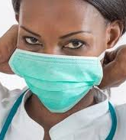
Will I Still need to wear a Mask?
YES !
Similar to other vaccines, a large number of people in the community will need to get vaccinated before transmission drops enough to stop the use of masks

Slide 13
2.
safety
How safe is the vaccine?

Slide 14
Are the COVID-19 Vaccines Safe?
Safety is the most important priority in vaccine approval
Monitoring for safety will continue as the vaccine is distributed to the public
To assess safety FDA typically advises that a minimum of 3,000 participants are included in the trial. The current COVID-19 vaccine trials include 30,000 to 50,000 participants

Slide 15
Why should we trust the COVID-19 Vaccine?
The FDA is using the same strict standards that it has for decades
No steps are “skipped”
Two independent advisory committees are reviewing the results. Members and experts of these committees have no conflict of interest and are not associated with any vaccine manufacturers
The Vaccine and Related Biological Products Advisory Committee (VRBPAC) that advises the FDA
The Advisory Committee on Immunization Practices (ACIP) that advises the CDC

Slide 16
3.
process
How will the vaccine be administered?

Slide 17
Vaccine process
How: 2 injections, 21 or 28 days apart depending on manufacturer
Where: Currently at the Oakley Lindsey Center
When: as product is available, IDPH will deploy to eligible groups

Slide 18
Currently Eligible Groups
https://www.co.adams.il.us/government/departments/health-department/covid-19-vaccination-information

Slide 19
What should I Expect When I Get the vaccine?
YOU MUST GET THE SECOND DOSE because the vaccine will not protect you if only get one dose
It is important to get the VACCINE from the SAME MANUFACTURER as the first dose

Slide 20
Who will benefit the most from the vaccine? Things to consider:
Employees who have had confirmed Covid-19 infection
Even if you have had COVID-19, it is important to get vaccinated. It could give you better protection against the disease
Even if you have positive antibodies, you should get the COVID-19 vaccine
Employees with high risk medical conditions highly encouraged for vaccination
Age >65
BMI>35
Chronic kidney disease
Diabetes
Age >55 and HTN or heart or lung disease
Employees with conditions that have not yet been studied
Pregnancy
Immune compromise
Consider risk:benefit ratio and discuss with your Primary Care Provider

Slide 21
Who should be cautious about the decision to receive the vaccine?
Anyone with a prior allergic reaction to any vaccine
Anyone with a history of hypersensitivity reactions

Slide 22
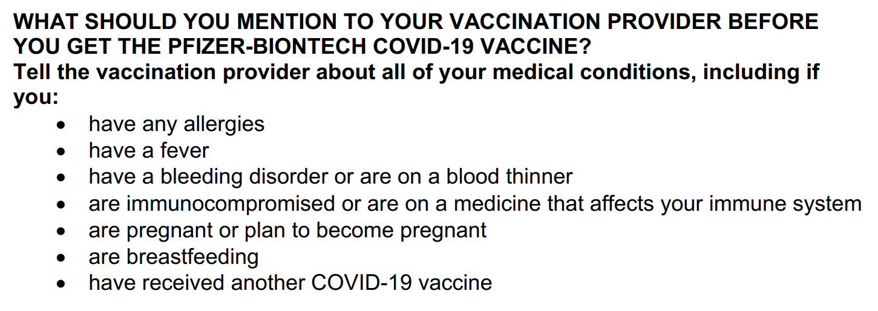
If you have concerns about whether Covid-19 Vaccination is right for you, you should reach out to your Primary Care Provider. The Blessing Covid Hotline will not be giving medical advice.

Slide 23
4.
Post-vaccination symptoms
What do I do if I have symptoms after vaccination?

Slide 24
What should I Expect When I Get the vaccine?
THE VACCINE CANNOT GIVE YOU COVID-19!
You can expect to have pain at injection site after vaccination
You may also have short-term: fatigue, headache, muscle pain, chills, fever These reactions will last for 24-48 hours and are typically more pronounced after the second dose
Side effects mean your body is doing its job and making antibodies (IT IS A GOOD THING)
These side effects are normal, common and expected. They are usually mild.

Slide 25
New onset post-vaccination symptoms
Employees who
have received Covid-19 vaccine in the prior 3 days and
Have no exposures in past 14 days
May work if they are afebrile for 24 hours and do not have:
Cough, shortness of breath, rhinorrhea, sore throat, loss of taste or smell

Slide 26
Where should I look to get accurate information?
It is important to get information from reliable sources (CDC, AMDA, medical directors, providers) Social media is full of misinformation and opinions based on that misinformation
Here are some link to information:
CDC: https://www.cdc.gov/vaccines/hcp/covid-conversations/answering-questions.html
CDC: About COVID-19 vaccines: https://www.cdc.gov/coronavirus/2019-ncov/vaccines/about-vaccines.html

